Slide 1

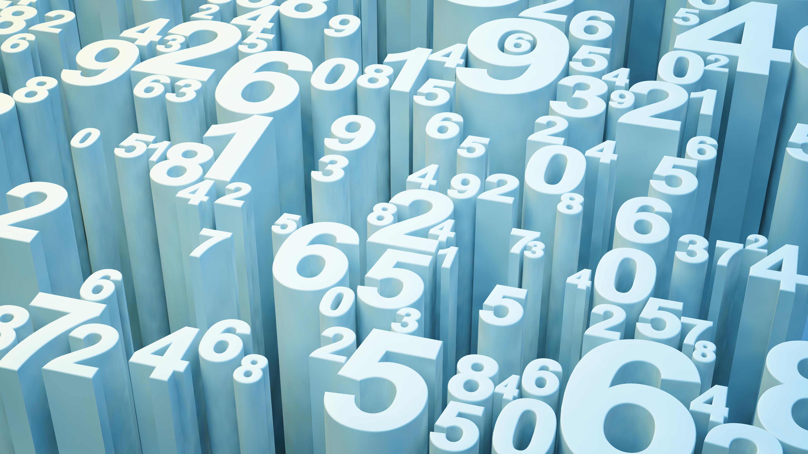
Wine Clustering
-The Sommelier Problem

Slide 2
Grouping Wine
OBJECTIVE
Gathering data.
Developing methods & functions.
Obtaining result.
IMPLEMENT
Converting data into array.
Calculating the distances.
Updating the weights.
Calculating separations.
RESULT
Running test case(s).
Displaying outputs.
Validating the model developed.

Slide 3
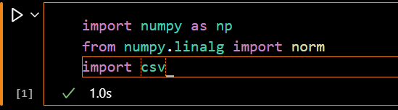
Initial Phase
Importing Libraries necessary:
Numpy: Used for numerical processing of the data like getting an array, matrices etc.
Numpy.linalg.norm: For calculating norms(magnitudes of vectors to be specific).
CSV: For reading a CSV file directly.

Slide 4
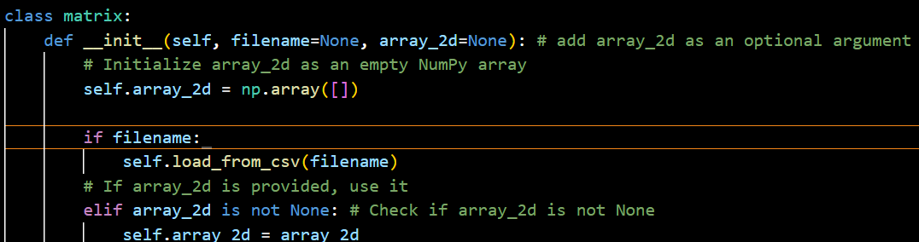
Classes & Methods
Defining a class named matrix() which has different methods as mentioned.
Initializing the class using the constructor for assigning and accessing the array_2d(each row represents a wine, and each column represents attributes) parameter and loading the data into the array_2d.

Slide 5
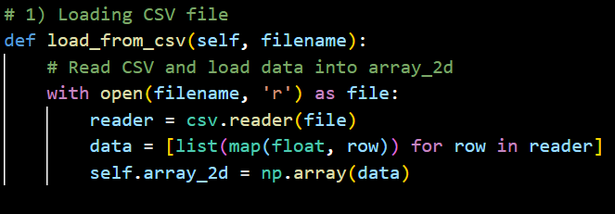
Loading… CSV
Loading the csv file as required and converting it’s rows as an array_2d as required:
This loaded file is to used by the constructor mentioned in the previous slide which gets us the required array_2d from the loaded data here;

Slide 6
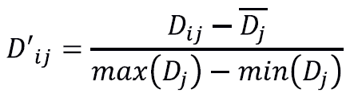
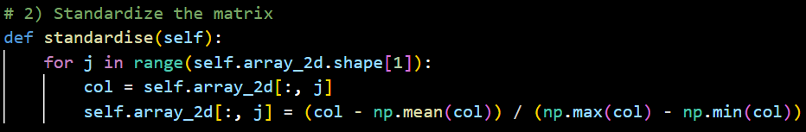
Standardizing
Standardizes the data so that each attribute has equal weight. This ensures that attributes like “alcohol content” (which may have larger numbers) don't dominate smaller attributes like “color intensity”.
Here this standardizing, every column in the data, is done on the array_2d that we got from the previous step;

Slide 7
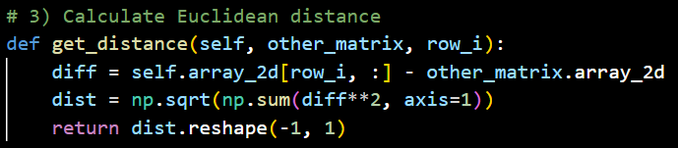
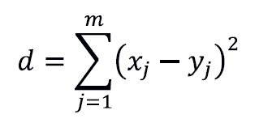
Getting Distance
After standardizing the data we need to calculate the distance(more specifically Euclidean)between a specified wine (row_i) and all other wines in a different matrix(other_matrix):
More details of the other_matrix are understood as we move further;

Slide 8
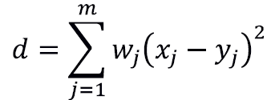
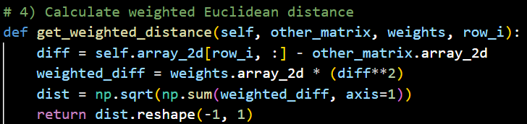
Weighted Distances
This method calculates the weighted distances where each attribute can have a different importance (weight) during distance calculation:
It’s clear that here the calculated distances are the multiplied by the weights that we obtain, and hence the implementation is similar to the previous step;
Where reshaping is done to convert into column vector.

Slide 9
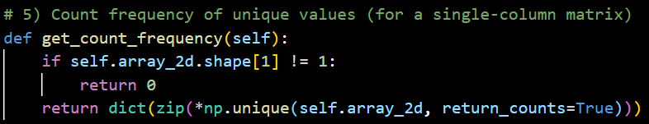
Frequency calculation
We count the frequency of each value in the matrix. It’s useful for determining how many wines belong to each group once clustering is complete.

Slide 10
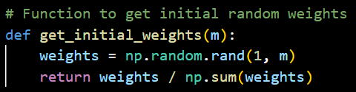
Functions Initialization
The first function involves generating random weights for each attribute. These weights are used in the weighted distance calculations to determine the importance of each attribute.

Slide 11
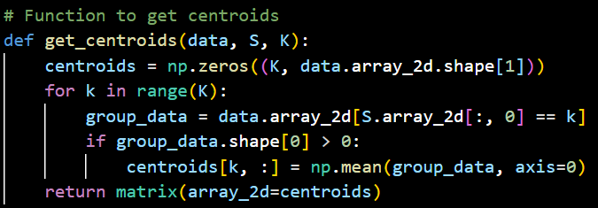
Obtain Centroids
Given a set of groups (cluster assignments) in matrix S(which is obtained further), this function calculates the centroids(the “mean” wine in each group). It returns the updated centroids, which will be used to improve the clusters.

Slide 12
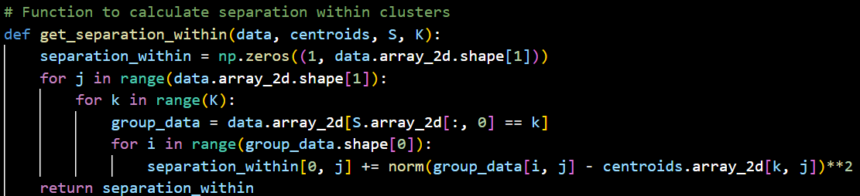
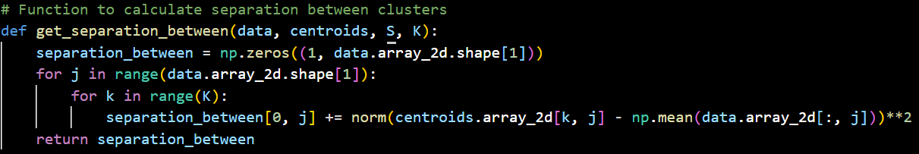
Separation Functions
These functions calculate the separation within clusters and separation between clusters. Separation within refers to how close the wines in a cluster are to each other,
While separation between measures how far apart the clusters are from each other. These metrics help in updating the clusters and improving the model.

Slide 13
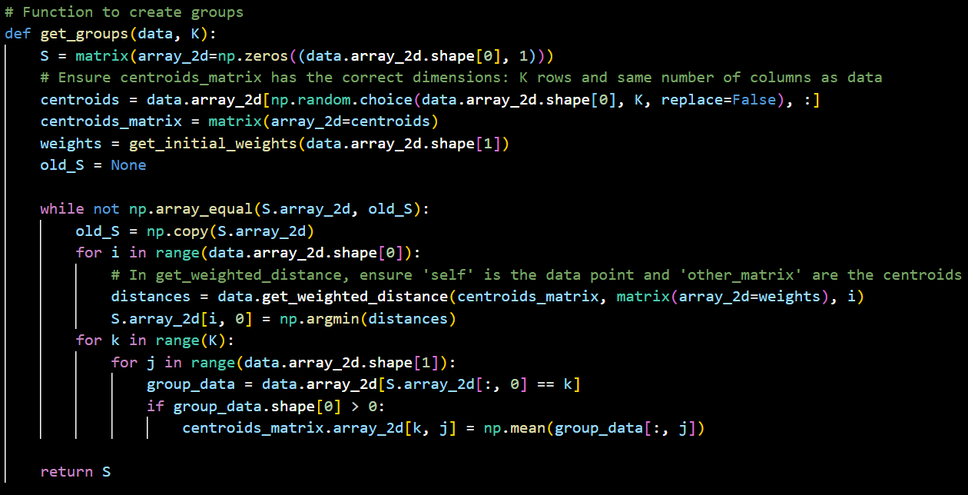
Getting Groups
This is the main clustering function. It assigns each wine to one of the K clusters by calculating the weighted distances and updates the cluster assignments (S). It runs multiple iterations until the groups (S) stabilize.

Slide 14
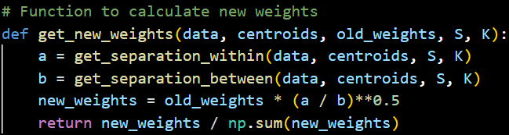
Updated Weights
Updates the weights of the attributes based on the separations within and between clusters. This step ensures that attributes that are more important for distinguishing between clusters get more weight.

Slide 15
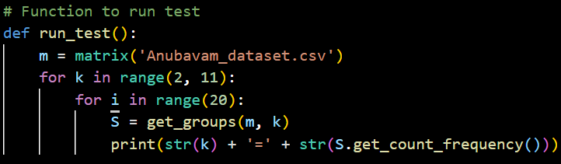
Final Run
The run_test function runs this entire clustering process for different values of K (from 2 to 10) and prints the cluster assignments (in terms of the frequency of wines in each group).

Slide 16
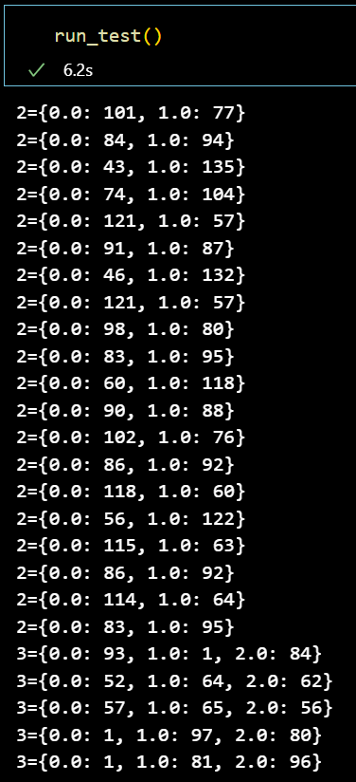
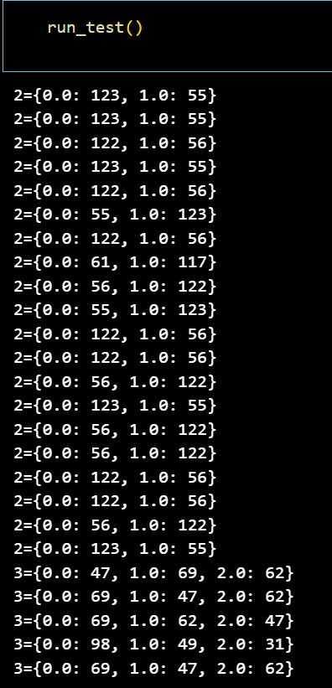
Test Cases
Data_set-1
Data_set-2

Slide 17
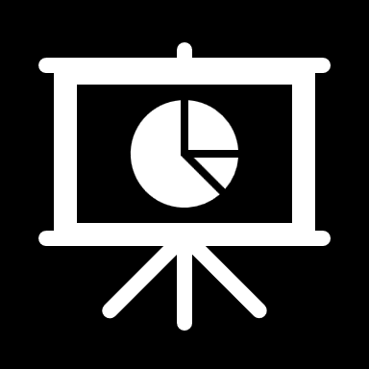

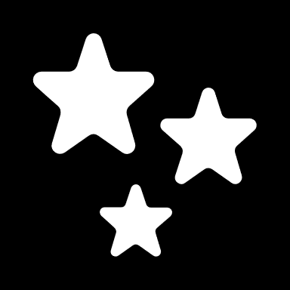
Thank You
Presented by:
Venkata Sai Bhaskar Achalla
Mail: bhaskarachalla054@gmail.com
Ph.No: +91-8523078272

